Slide 1
Tower of Hanoi

Slide 2
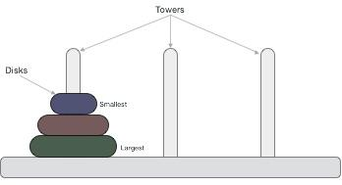
Tower of Hanoi
Tower of Hanoi, is a mathematical puzzle which consists of three towers (pegs) and more than one rings is as depicted −
These rings are of different sizes and stacked upon in an ascending order, i.e. the smaller one sits over the larger one. There are other variations of the puzzle where the number of disks increase, but the tower count remains the same.

Slide 3
Concept
There are three pegs say A, B and C.
The different diameters of n discs are placed one above the other.
Peg A is Source peg, Peg B is intermediate or temporary peg and peg C is destination peg.
The problem is to shift all discs from Peg A to Peg C by making temporary Peg
The rules to be followed while transferring the disc are:
Only one disk can be moved among the towers at any given time.
Only the "top" disk can be removed.
No large disk can sit over a small disk.

Slide 4
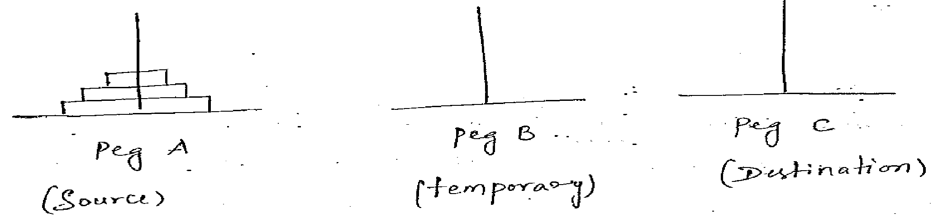
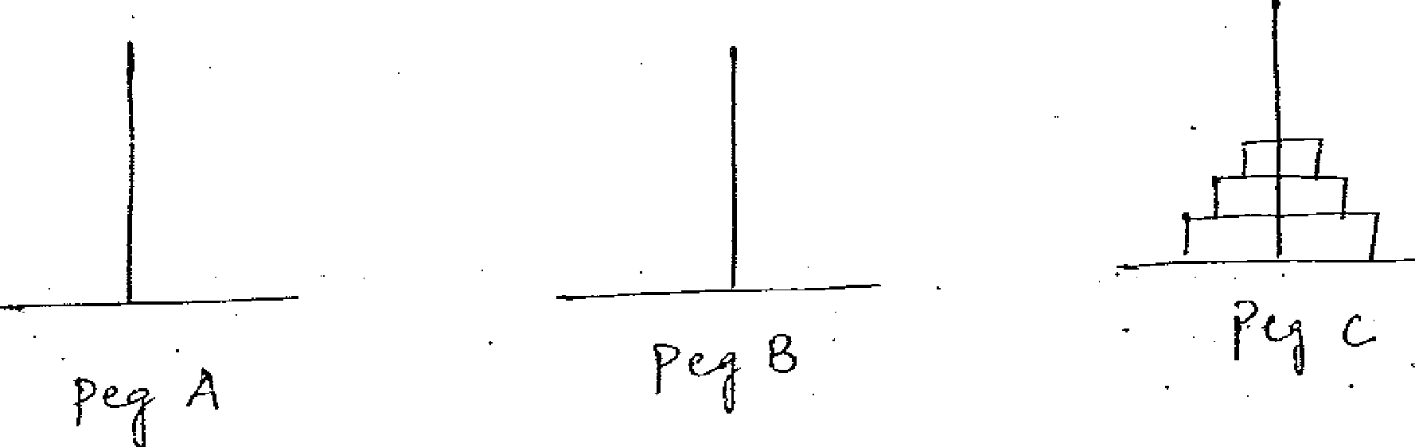
The initial setup is
After transferring all the disc to peg C from peg A,

Slide 5
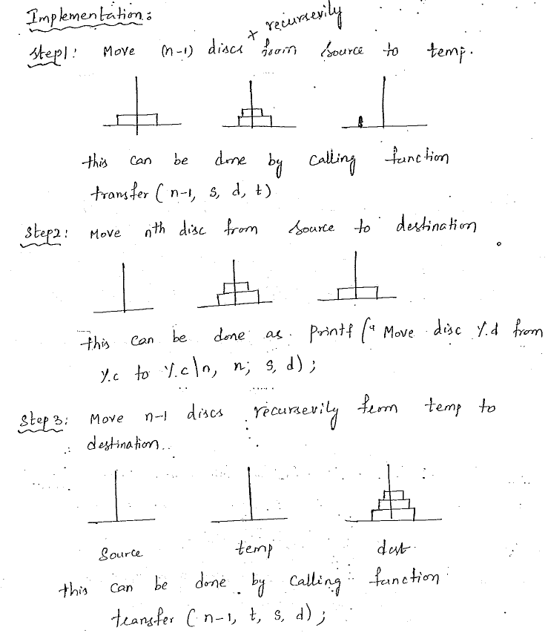

Slide 6
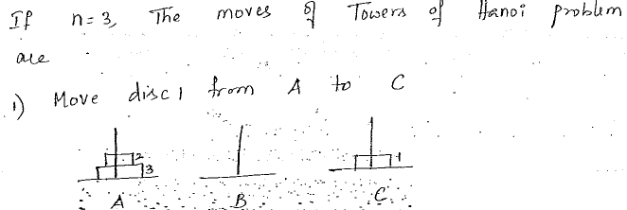
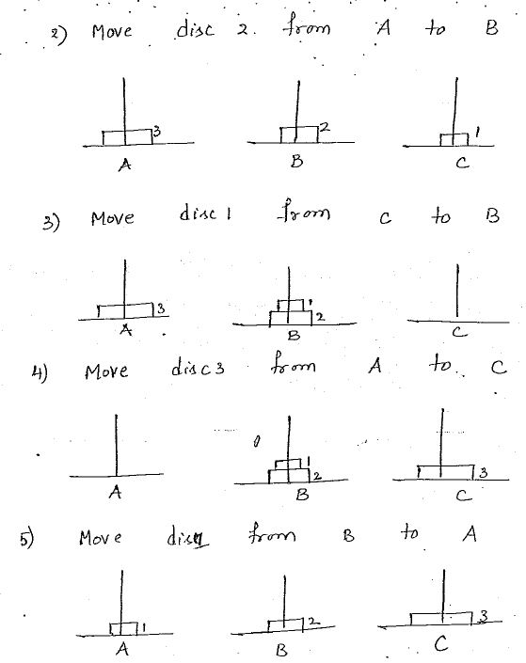
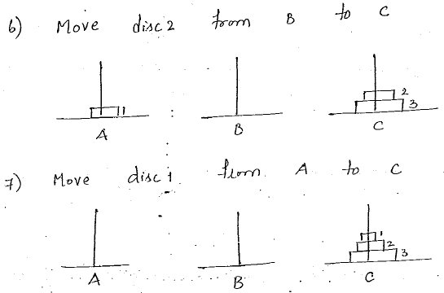

Slide 7
Algorithm for Tower of Hanoi can be driven as follows −
START
Procedure Hanoi(disk, source, dest, temp)
IF disk == 1, THEN
move disk from source to dest
ELSE
Hanoi(disk - 1, source, temp, dest) // Step 1
move disk from source to dest // Step 2
Hanoi(disk - 1, temp, dest, source) // Step 3
END IF
END Procedure
STOP

Slide 8
